Slide 1
8085 Memory Mapping

Slide 2
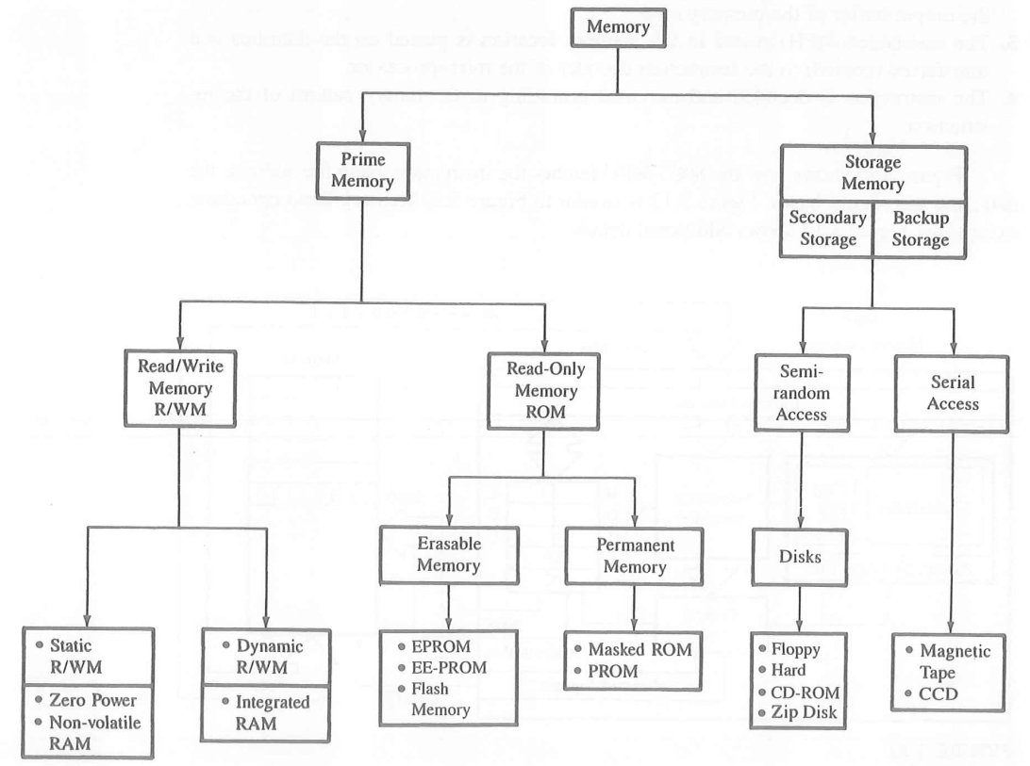
Memory Classification

Slide 3
Memory
Stores binary instructions and data for the microprocessors
Primary Memory – R/W and ROM
R/W- made of registers
ROM-stores information permanently in the form of diodes
To communicate with the memory, MPU should able to
Select the chip
Identify the register
Read from or to write into the register

Slide 4
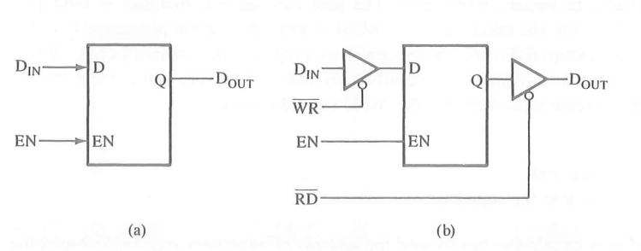
Latch as a storage element

Slide 5
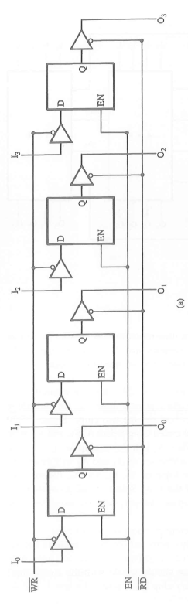
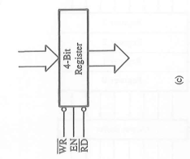
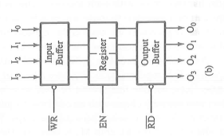

Slide 6
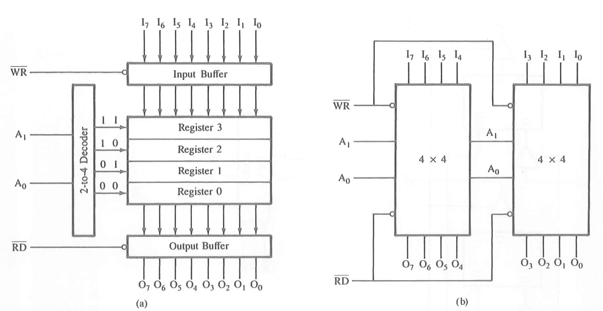
4x8 Bit register

Slide 7
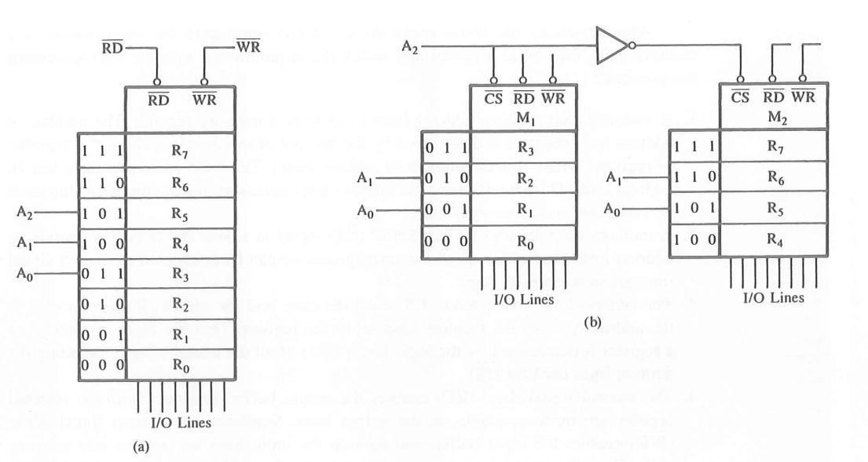

Slide 8
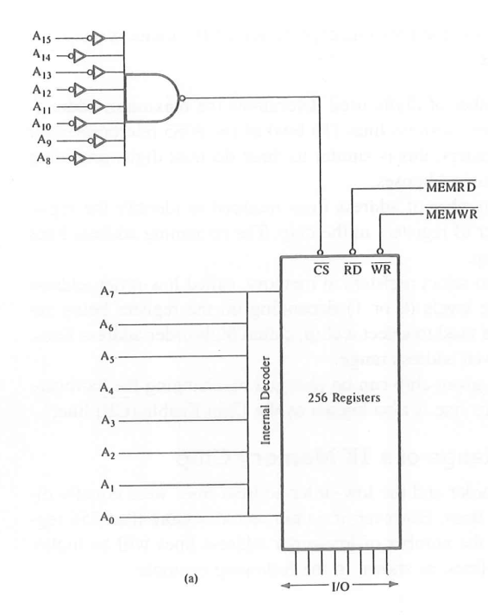
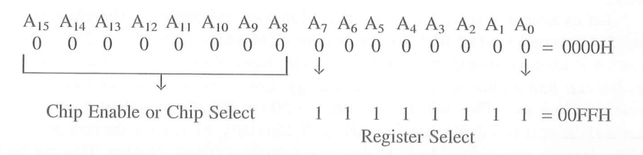
Memory Mapping
256 Bytes of Memory

Slide 9
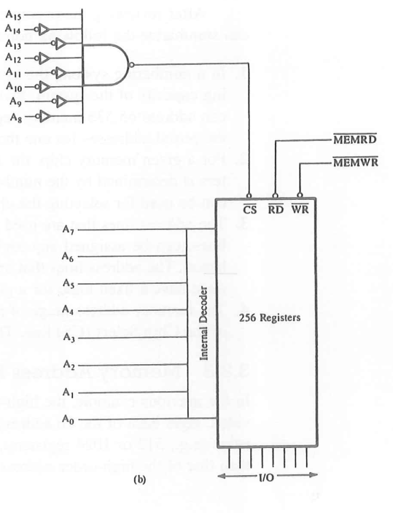

Memory Address ranging from 8000H to 80FFH

Slide 10
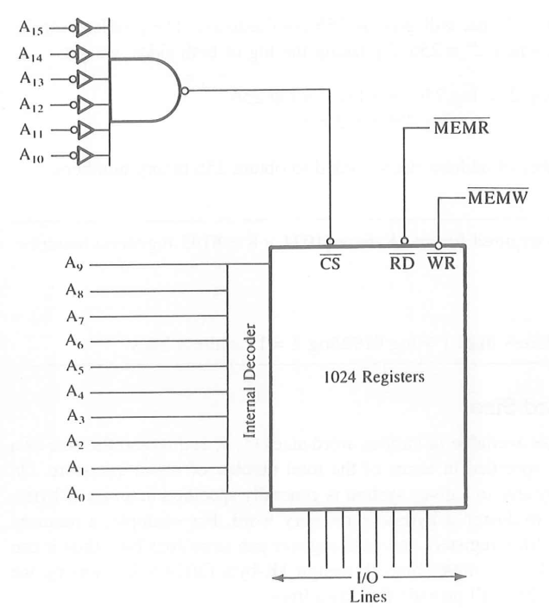
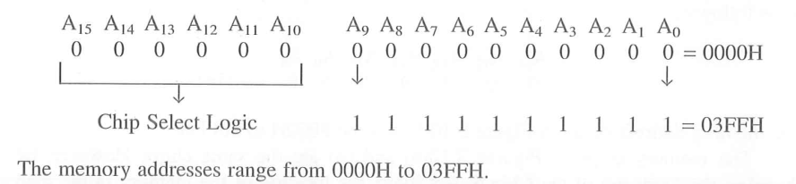
Memory Address Range of 1K Memory Chip

